Slide 1

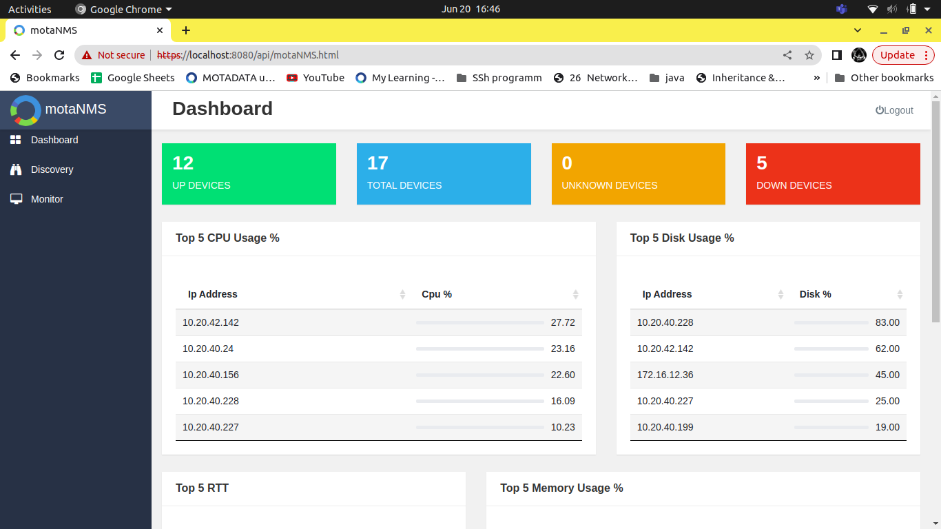
motaNMS
Realtime network monitoring system

Slide 2
Objective
The main objective of network monitoring system is to provide real-time visibility into network performance and security, enabling proactive issue detection and faster problem resolution

Slide 3
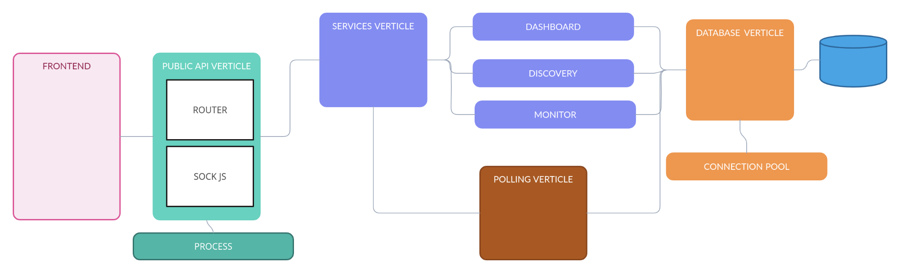
High level design

Slide 4
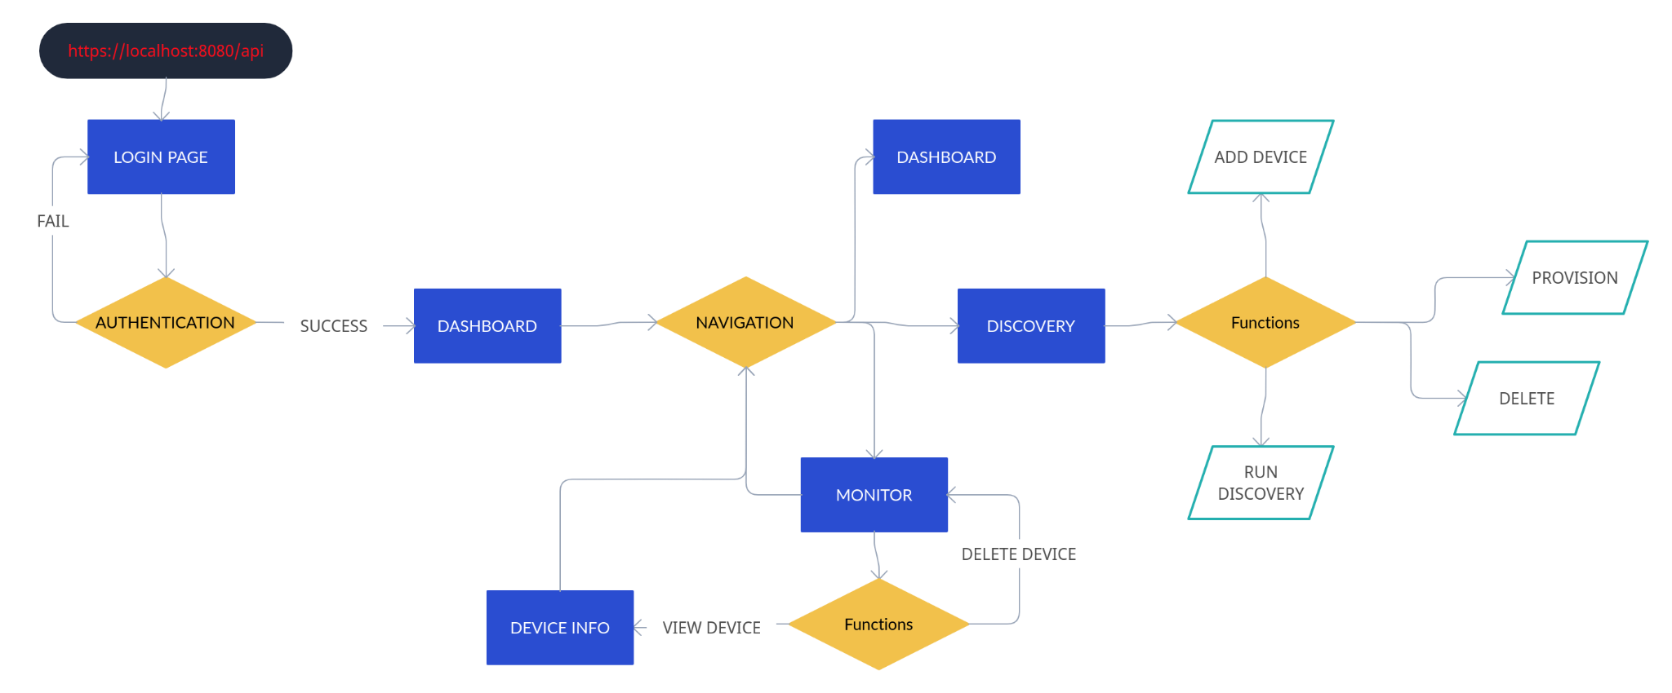
General flow

Slide 5
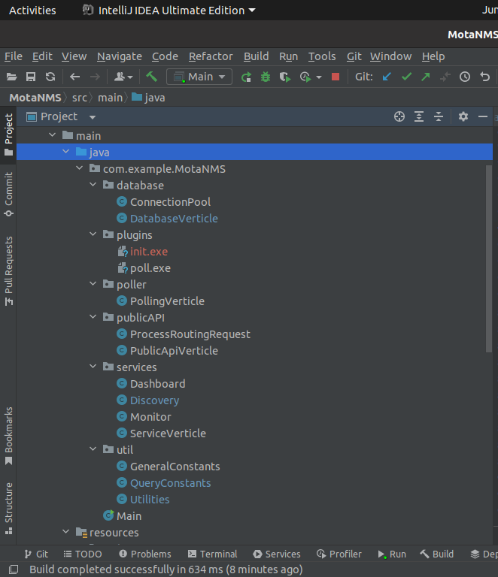
Folder structure.

Slide 6
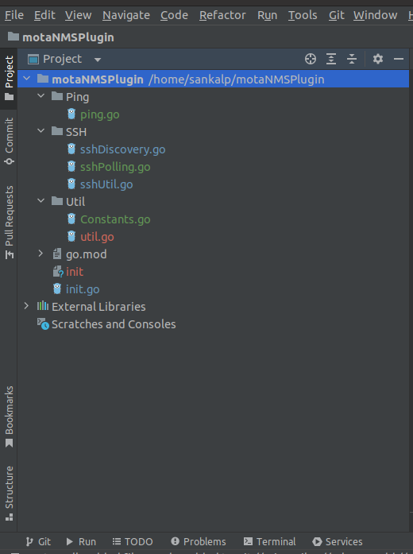
Folder structure GoLang

Slide 7
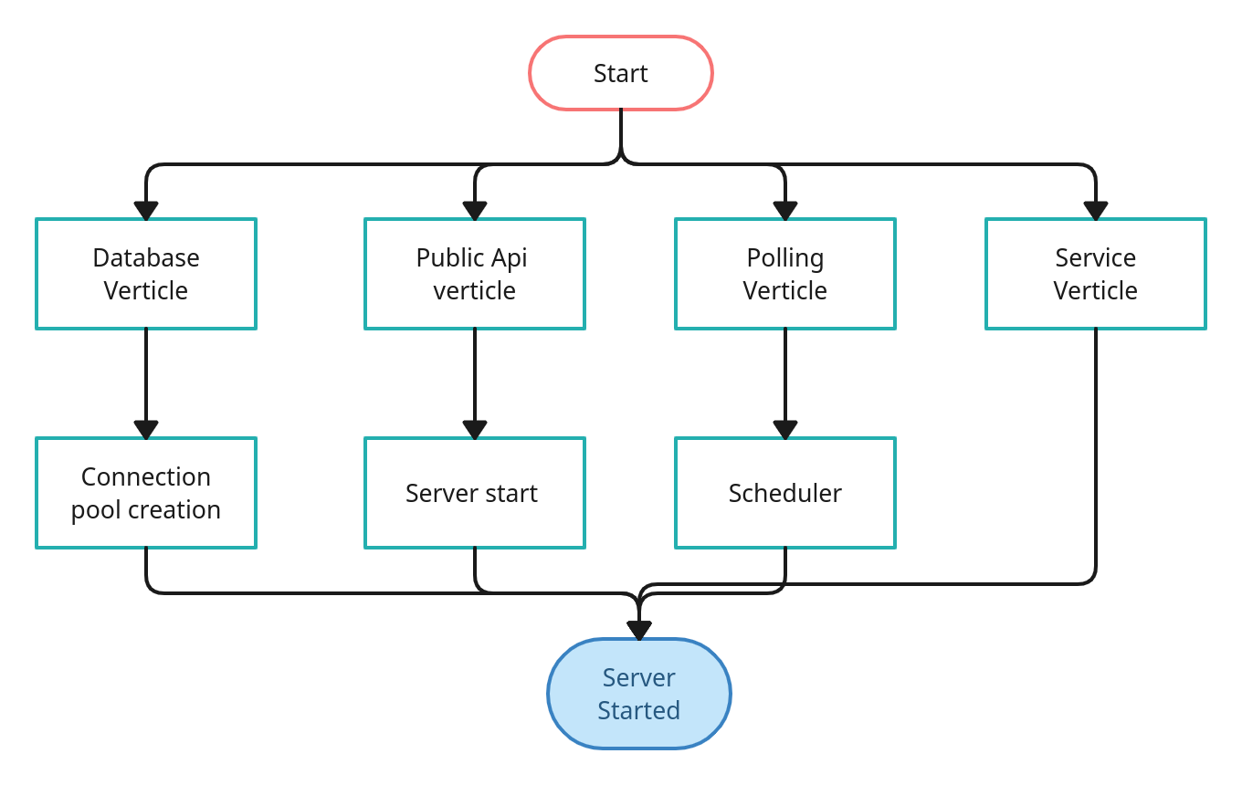
What’s happening under the hood ?
On server Startup
On failure of any operation shown will result in shut down of server , vertx will be closed.

Slide 8
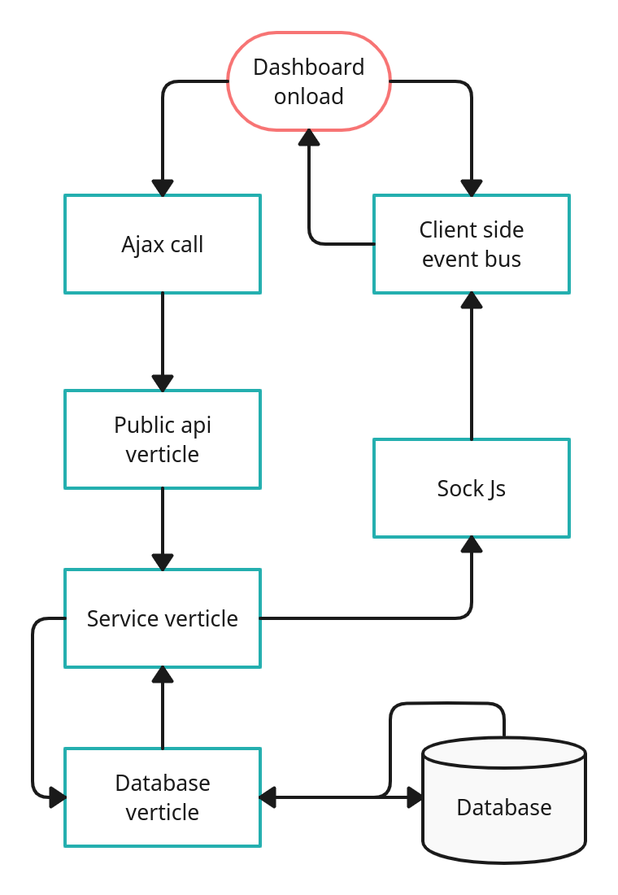
DashBoard
On load

Slide 9
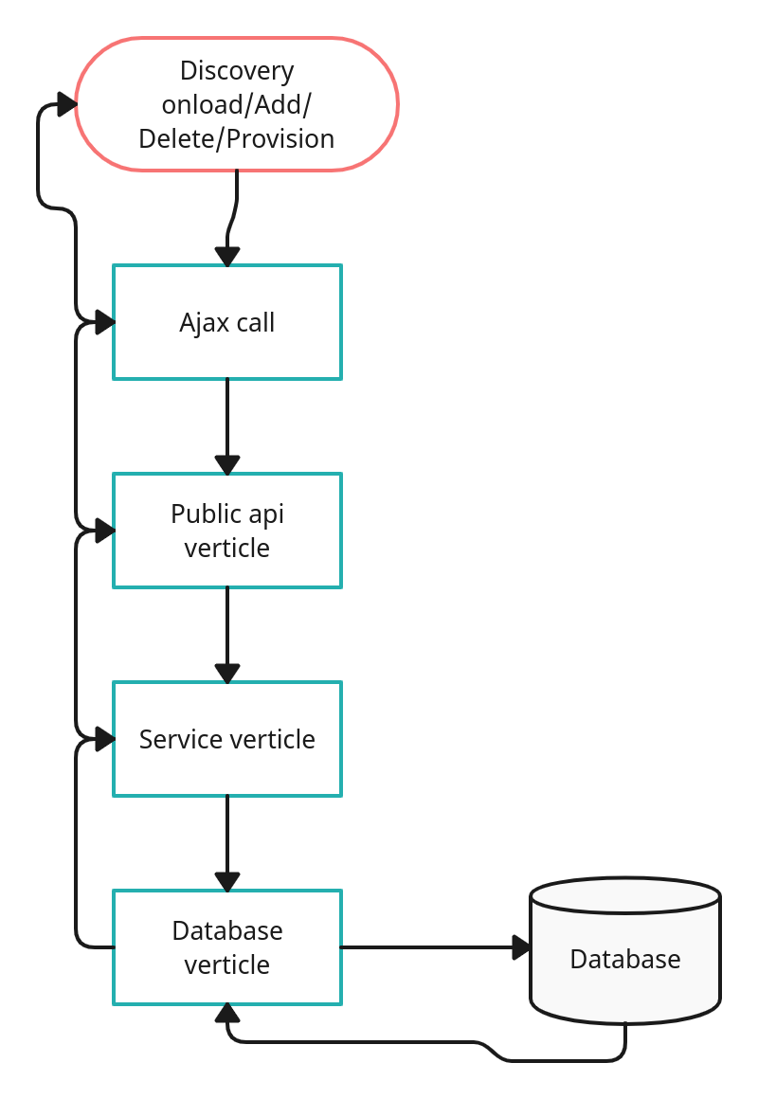
Discovery & Monitor
Onload/Add/
Delete/Provision
/View

Slide 10
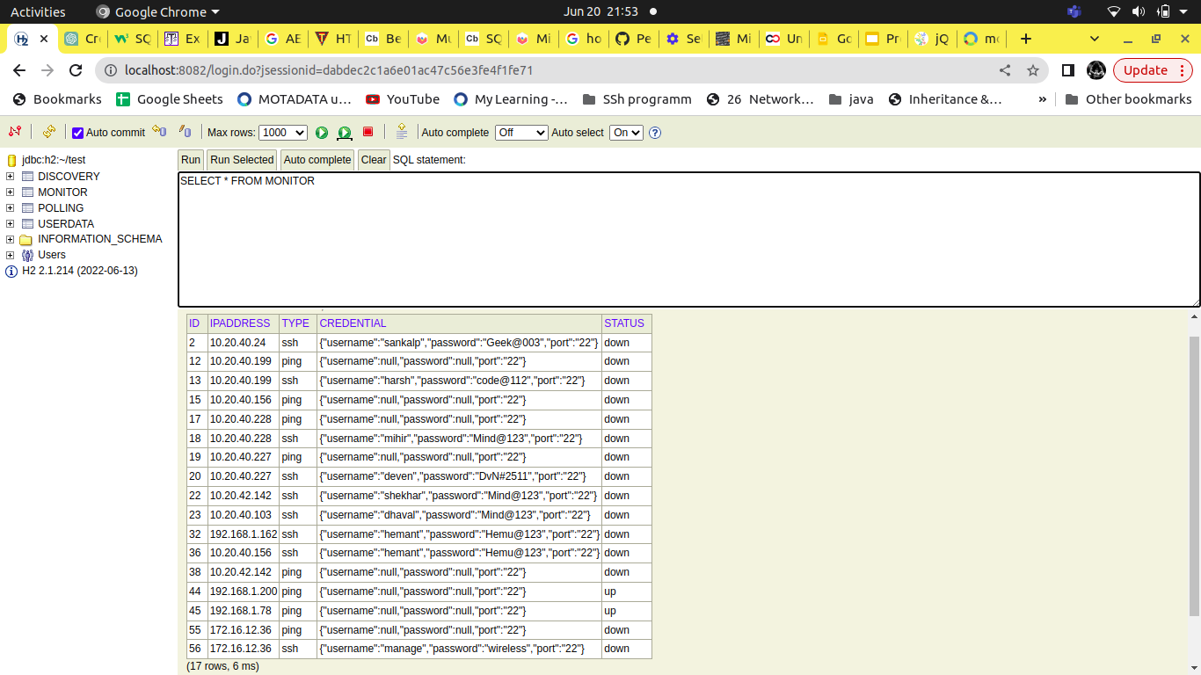
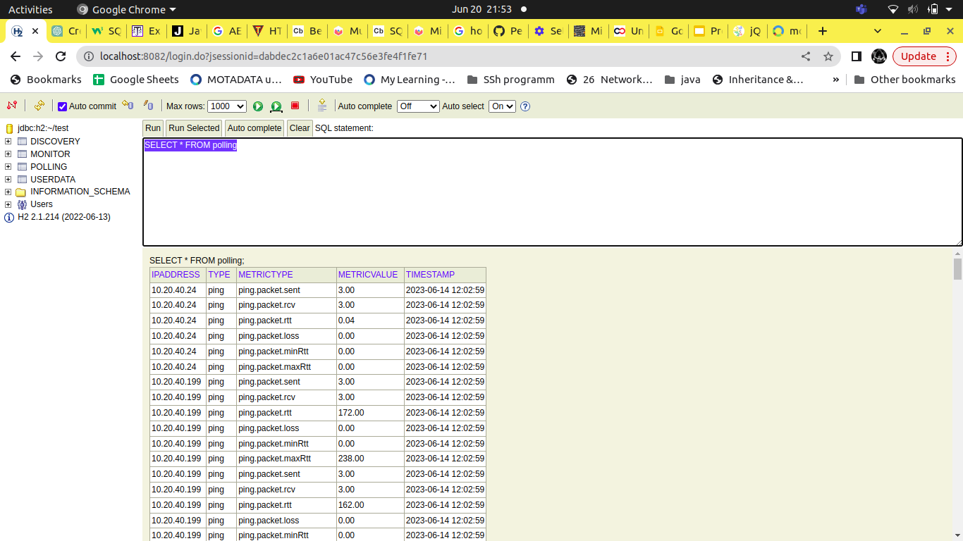
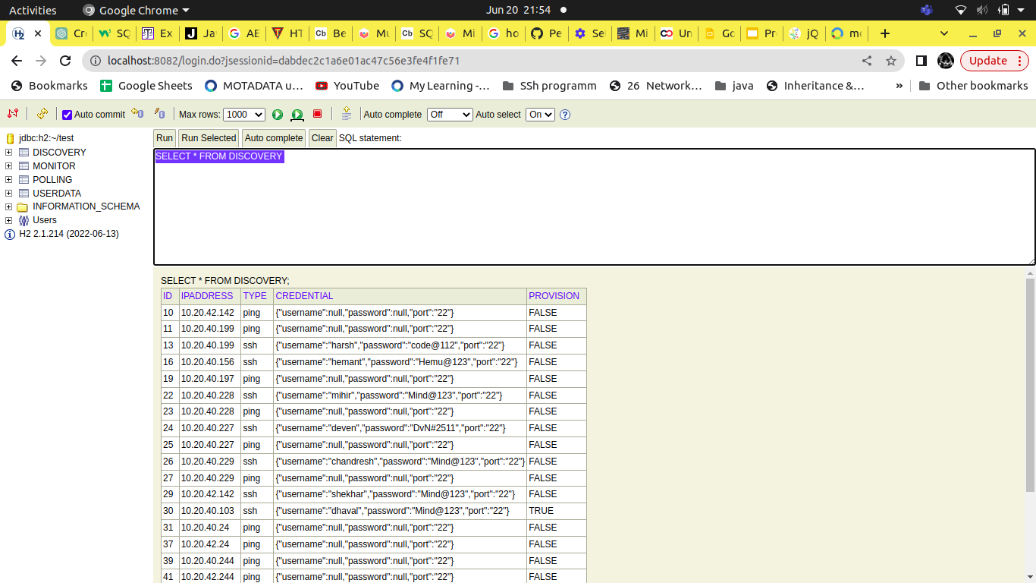
Tables

Slide 11
Improvements
Specified Worker Pool Size for verticles
Made connection pool singleton for multiple instances of Database verticle
Added widget to show Network interfaces Data

Slide 12
Present features
Real time data representation
Historical data visualization
Discovery
Device type Supported (Ping/ssh)
Batch polling
One page ui

Slide 13
Future Scope
Error messages from plugin
Increase metric types
Add new device type(snmp/windows)
Range discovery

Slide 14
Questions?

Slide 15
Thank you

